Slide 1
Project „easystats“ Making R stats easier!
16th Meeting of the Hamburg R-User-Group, 13th Feb 2019

Slide 2

https://github.com/easystats

Slide 3

https://github.com/easystats
Neuropsychologist, psychotherapist, pizza lover 🍕
Postdoc at the Clinical Brain Lab (Singapore) on the neuroscience of deception
Dominique

Slide 4


https://github.com/easystats
Neuropsychologist, psychotherapist, pizza lover 🍕
Postdoc at the Clinical Brain Lab (Singapore) on the neuroscience of deception
Gerontologist, kind of sociologist, prefers burgers
Postdoc at the Department of Medical Sociology (University Medical Center Hamburg)
Dominique
Daniel

Slide 5

Objectives
Provide a set of packages that makes it easier to do statistical analysis and reporting with R.
Low-level (or „core“) packages
Target group: advanced users and developers
Aims (examples): accessor functions to access the internals of models, such as variables, formulas, model frame/data, random effects, their structure and so on...

Slide 6
Objectives
Provide a set of packages that makes it easier to do statistical analysis and reporting with R.
Mid-level packages
Target group: end-user
Aims (examples): computation of model "performance" metrics (R2, ICC, CoD, AIC, BIC and whatnot), model comparison, Bayesian analysis, …

Slide 7
Objectives
Provide a set of packages that makes it easier to do statistical analysis and reporting with R.
High-level packages
Target groups: non-experts/beginners who want fully-baked solutions to solve their problems and to experience the power of R
Aims: reporting, plotting

Slide 8

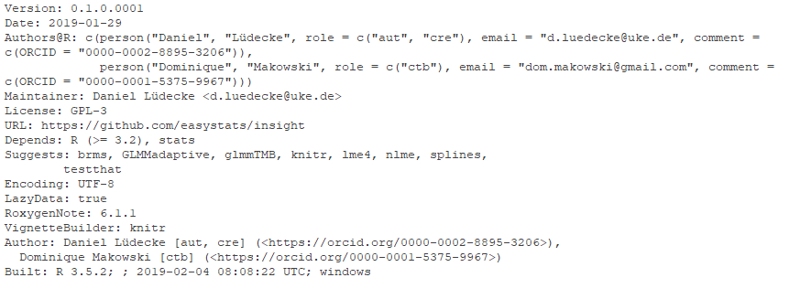
Objectives
Provide a set of packages that makes it easier to do statistical analysis and reporting with R.
And most important!
All packages, especially the low-level packages, should run with minimum dependencies!
and no imports!

Slide 9
insight
A first low-level package…

Slide 10

Model objects are terrifying
# model frame?
library(nlme)
m <- gls(
follicles ~ sin(2*pi*Time) +
cos(2*pi*Time), Ovary,
correlation = corAR1(form = ~ 1 | Mare)
)
model.frame(m)
#> corStruct parameters:
#> [1] 1.960656

Slide 11
Model objects are terrifying
# model family?
fm1 <- lme(
distance ~ age, data = Orthodont
)
family(fm1)
#> Error in UseMethod("family") :
#> no applicable method for 'family’ #> applied to an object of class "lme"

Slide 12
Model objects are terrifying
# model terms?
library(MCMCglmm)
data(PlodiaPO)
m <- MCMCglmm(
PO~1, random=~FSfamily, data=PlodiaPO,
verbose=FALSE, nitt=1300, burnin=300,
thin=1
)
all.vars(terms(m))
#> Error in terms.default(m) : no
#> terms component nor attribute

Slide 13

Gain insight into your models!

Slide 14

Gain insight into your models!
Thanks to a stunning x-ray-technology, the insight-package allows to easily get insights into your model object!
without insight…
with insight…

Slide 15
Gain insight into your models!
Simple, consistent API:
get_*() to retrieve data, find_()* to access model information.
without insight…
with insight…

Slide 16
Objectives
The goal of this package is to provide tools that make it easy and intuitive to access information contained in various models.
Although there are generic functions to get information and data from models, many modelling-functions from different packages do not provide such methods to access these information.
insight aims at closing this gap by providing consistent functions that work for (almost) any models.

Slide 17
I‘m afraid of no model
library(insight)
library(nlme)
m <- gls(
follicles ~ sin(2*pi*Time) +
cos(2*pi*Time), Ovary,
correlation = corAR1(form = ~ 1 | Mare)
)
get_data(m)
#> Mare Time follicles
#> 1 1 -0.13636360 20
#> 2 1 -0.09090910 15
#> 3 1 -0.04545455 19
#> ... (truncated)

Slide 18
I‘m afraid of no model
library(MCMCglmm)
data(PlodiaPO)
m <- MCMCglmm(
PO~1, random=~FSfamily, data=PlodiaPO,
verbose=FALSE, nitt=1300, burnin=300,
thin=1
)
find_terms(m)
$response
[1] "PO"
$conditional
[1] 1
$random
[1] "FSfamily"

Slide 19
I‘m afraid of no model
library(GLMMadaptive)
m <- mixed_model(
count ~ child + camper,
random = ~ 1 | persons,
zi_fixed = ~ child + livebait,
zi_random = ~ 1 | persons,
data = fish,
family = zi.poisson()
)
find_predictors(m, component = "zi")
#> $zero_inflated
#> [1] "child" "livebait"

Slide 20

Tell others about your research!

Slide 21
Objectives
Higher-level package.
report’s primary goal is to fill the gap between R’s output and the formatted result description of your manuscript, with the automated use of best practices guidelines.
This ensures standardization and quality of reporting research results.

Slide 22
From R to Manuscript
Short form summary:
lm(Sepal.Length ~ Species, data=iris) %>%
report()
## We fitted a linear model to predict Sepal.Length with Species.
## The model's explanatory power (R2) is of 0.62 (adj. R2 = 0.61).
## The model's intercept is at 5.01.
## Within this model:
## - Speciesversicolor is significant (beta = 0.93,
## 95% CI [0.73, 1.13], p < .001) and large (Std. beta = 1.12).
## - Speciesvirginica is significant (beta = 1.58,
## 95% CI [1.38, 1.79], p < .001) and large (Std. beta = 1.91).

Slide 23








Want to join us?
https://github.com/easystats
Dominique & Daniel
And many more packages to come…

Slide 24
Want to join us?
We are...
waiting for your feedback
open to opinions and ideas
beginning-developers friendly
https://github.com/easystats
Dominique & Daniel

